Slide 1
Business Process Engineering
Process Redesign
Lecture: 12

Slide 2
Process redesign

Slide 3
Process redesign approaches
Exploitative Redesign (transactional)
Doesn’t put into question the current process structure
Seeks to identify problems and resolve them incrementally, one step at a time
Explorative Redesign (transformational)
Puts into question the fundamental assumptions and principles of the existing process structure
Aims to achieve breakthrough innovation
Example: Heuristic redesign
Example: Business Process Reengineering (BPR)
Notes:
Aims to achieve breakthrough innovation, for example by removing costly tasks that do not directly add value

Slide 4
Heuristic Process Redesign
A method to identify changes to an “as is” process based on a collection of heuristics that strike tradeoffs between:
Cost
Time
Quality
Flexibility

Slide 5
Performance measures: the Devil’s Quadrangle
Cost
Time
Flexibility
Quality
Notes:
A great deal of BPM is about improving process performance, particularly in terms of time, cost and quality. In order to improve performance, we first need to be able to measure it. We can classify performance measures along these four most common dimensions.
one of those toys that when you stretch it in one direction, it shrink in the other direction, i.e. when you gain in one direction you may loose in the other direction

Slide 6
Flexibility
Ability to react to changes in:
Workload
Customer demands and expectations
Resource and business partner availability and performance
Example: Following natural disasters (e.g. storms), the number of home insurance claims increases by tenfold
To address this surge, flexibility is required at:
Resource level: Staff redeployment, faster performance
Process level: Performing tasks differently to speed up the front-end
Management: Relaxing business rules and controls where possible
Notes:
A dimension of your process. Ability to react to changes in process

Slide 7
Redesign Heuristics
Task-level
Task elimination
Task composition/decomposition
Triage
Flow-level
Re-sequencing
Parallelism enhancement
Process-level
Specialization & standardization
Resource optimization
Automation
Communication optimization
Notes:
Finally automation, because it’s most effective, as we have seen, to do automation after we have applied as much as possible the other heuristics

Slide 8
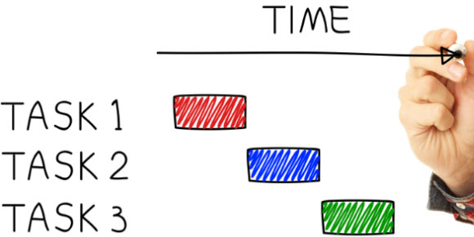
Task-level redesign heuristics
Task elimination
Task composition/decomposition
Triage

Slide 9

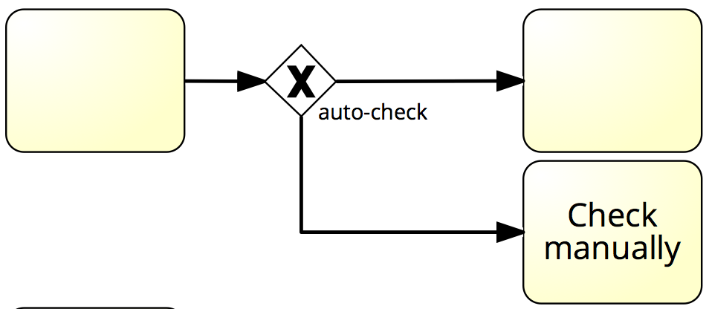

H1. Task elimination
Eliminate non-value-adding steps wherever these can be isolated
Forward, send, receive, …
Consider reducing manual control steps (checks & approvals) by:
Skipping them where feasible
Replacing them with statistical controls
Skipping them selectively
+ Statistical Control
Notes:
- forwarding, sending, receiving documents or data around the process with no value added to it. (e.g. Ford procure-to-pay process)
reducing, if not eliminating, control steps (such as checks). Very rare these checks are useless, so instead of eliminating, we can consider to:
replace these manual checks with statistical control. Skip the check and from time to time pick a sample and review what would have been the outcome of the check. If this is infrequent we keep going, otherwise we need to reinstate it.
try to (partially or fully automating) the check: those where we are sure there is no error we let through, those more critical we keep them manual

Slide 10
H1. Task elimination
(T+, C+/-, Q-)
Consider trade-off between the cost of the check and the cost of not doing it
Examples:
Procure-to-pay process: some types of employees are empowered to trigger isolated purchases below $500 without supervisor approval
Order-to-cash process: invoices from trusted suppliers under $1000 are not checked on a one-by-one basis
University admission process: authenticity check is very expensive, yet it leads to only 1% of applications being rejected
Notes:
Consider the trade-off between cost of check and cost of letting through a defective process instance and then bearing the cost of correcting the checks (see case of authenticity check: very costly but only 1% of checks fail)
order-to-cash: have a list of trusted suppliers, whose invoices below $1K we pay without checking. Then we do statistical control on results to see if we overpaid an invoice
Quality deteriorates when we let through defects, and this may have an impact (e.g. on our customers) that when we realize there’s an error (e.g. we removed a quality check which led to increasing the probability of defects by 10%). Now customers more often get products with defects. If a customer realizes the product has a defect, then the quality is compromised. Cost may improve by reducing the cost due to task elimination, or deteriorate for the cost of defects

Slide 11
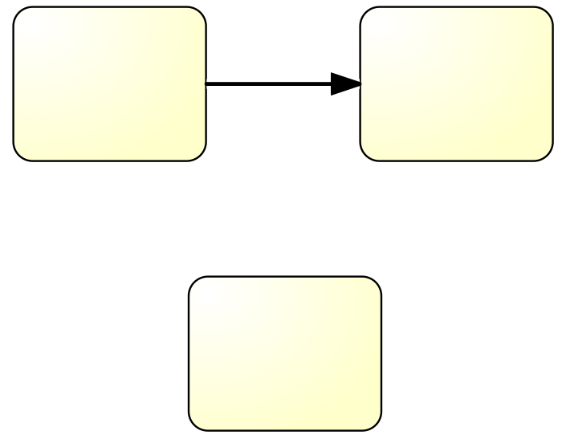
H2. Task composition/decomposition
Consider composing two tasks to eliminate transportation and reduce “context switches”, OR
Consider splitting a task into two and assign to separate, specialized resources
Notes:
In order to eliminate transportation costs and context switches by composing two tasks into one
Task decomposition, the contrary, tells us to assign the two tasks to more specialized resources, which, according to Adam Smith’s assembly line theory, more specialized resources can do better, rather than a generalist worker performing the entire “thick” task

Slide 12
H2. Task composition and decomposition
Composition example:
Procure-to-pay process: Merging two checks: “Check necessity of purchase” and “Check budget”
Decomposition example:
Make-to-order process: Separate a single thick “prepare quote” task into “prepare bill of materials”, “prepare production plan” and “estimate costs and delivery time”
Composition: (T+, C+/-, F+)
Decomposition: (T-, C+, F-)
Notes:
In the first example, is the handover of work between the two approvers takes too long
In the second example, it may be more effective to have an engineer specifically looking at bill of materials and production plan + a manager working out the cost and delivery time. Two different people with specialized skills might be able to do this work more efficiently than a single one
Composition:
T+: less handovers, hence lower cycle time
C+/-: depending on the cost of the process worker performing the combined task.
F+: with a generalist, we can more flexibly swap resources (resource flexibility is increased)
Decomposition:
T-: we introduce an handover
C+: specialists perfoming very efficiently faster, this leads to reduced cost
F-: now specialists are doing the work, hence resource flexibility is reduced as it’s now harder to swap resources.

Slide 13
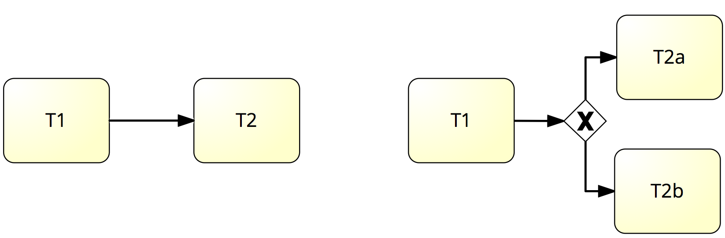
H3. Triage
Specialize a task: divide a general task into two or more alternative tasks
Generalize tasks: integrate two or more alternative tasks into one general task
Notes:
Specialize a task for certain types of cases, each assigned to specialized resources
Generalize tells us to integrate two variants of a single task into one

Slide 14
H3. Triage
Specialization example:
Procure-to-pay process: Separate approvals of small purchases, medium purchases and large purchases
Generalization example:
Make-to-order process: Integrate quote preparation for two product lines into one single task
Specialization: (T+, C+/-, F-)
Generalization: (T-, C+/-, F+)
Notes:
1) small (e.g stationery) to junior financial officers, medium (e.g. laptop) to senior financial officer, large (e.g. ERP system or IT infrastructure) to managers, while before it was all to the financial officer, who may in certain cases escalate the approval to a manager. Either divided per amount (small, medium, large) or per type (MRO vs ORM). I could combine this with task elimination by then removing the approval for small purchases, hence moving these simple cases much faster
2) different quotes for different product lines. Why not integrating them in order to have resources that are more flexible because they can handle a wider variety of products
Specialization
T+: we allow the shorter cases to move much faster (even without task elimination, the financial officer will be quicker than the manager)
C+/-: depending on which resource we assign to each specialized task and the cost of those resources. If now we have to channel certain requests towards managers or specialized resources, this may cost us more
F-: because with more specialization we loose flexibility
Generalization:
T-: we group all cases (shorter and faster) into a single pot
C+/-: again, even if we generalize, the cost involved depends on the resources we hire
F+: due to generalized resources being more flexible

Slide 15

Flow-level Redesign Heuristics
Re-sequencing
Parallelism enhancement

Slide 16
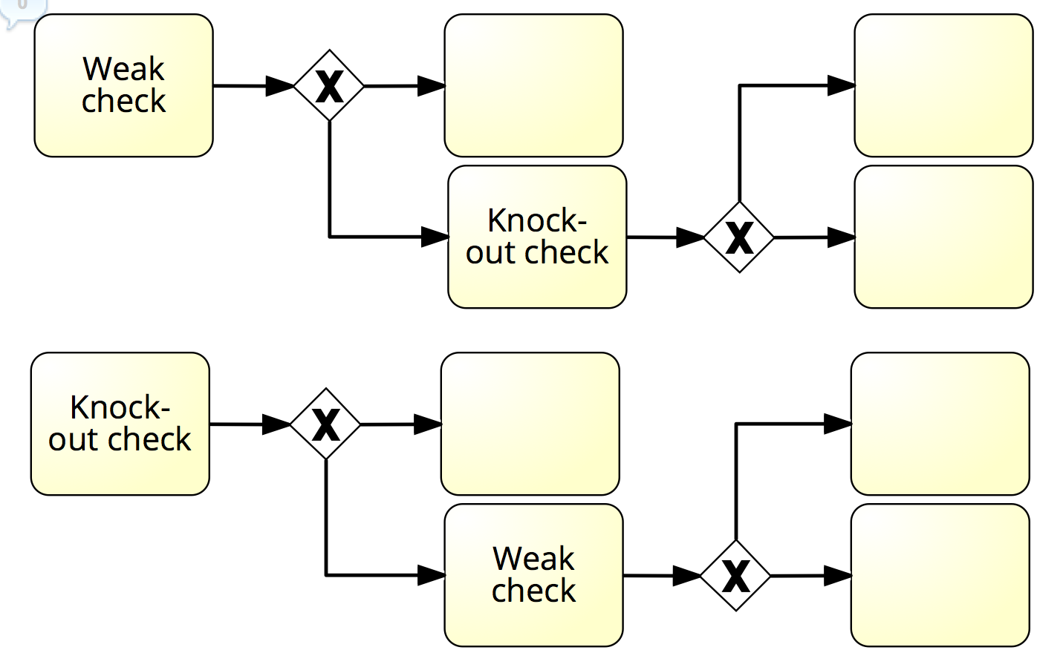
H4. Re-sequencing
Re-order tasks according to their cost/effect ratio to minimize over-processing
Postpone expensive tasks that may end up not being necessary until the end
Put knock-out checks first in order to identify problems early
Notes:
To reduce overprocessing. The idea is to put the strong knock-out checks earlier, according to their cost/effect ratio. How much does it cost vs how likely it is that this task will eliminate the need for other tasks to be performed (the higher the knock-out, the higher the chances the task will eliminate the need for other tasks). So we need to:
postpone expensive tasks to late in the process, when they are absolutely needed
put tasks with higher knock-out effects earlier, in order to maximize their effect
In the example, which only finds errors in a small percentage of cases, vs the knock-out check which finds it in a large percentage of cases

Slide 17
H4. Re-sequencing
(T+,C+)
Examples:
Make-to-order process: If “Prepare production plan” is time-consuming, postpone it until after the quote price has been tentatively accepted by the customer
Procure-to-pay process: If “Check necessity of purchase” leads to 20% of knock-outs and “Check budget” leads to 2%, perform “Check necessity of purchase” first
University admission process: authenticity check (very slow) leads to 1% of applications being rejected while committee’s check leads to 80% of applications being rejected. Put committee’s check first
Notes:
first, we do a tentatively accepted quote,
2) it is very rare that we do not proceed with the approval for a purchase because of insufficient budget
T+: time improves because negative cases are knocked-out earlier
C+: reduced cost because we over-process less

Slide 18
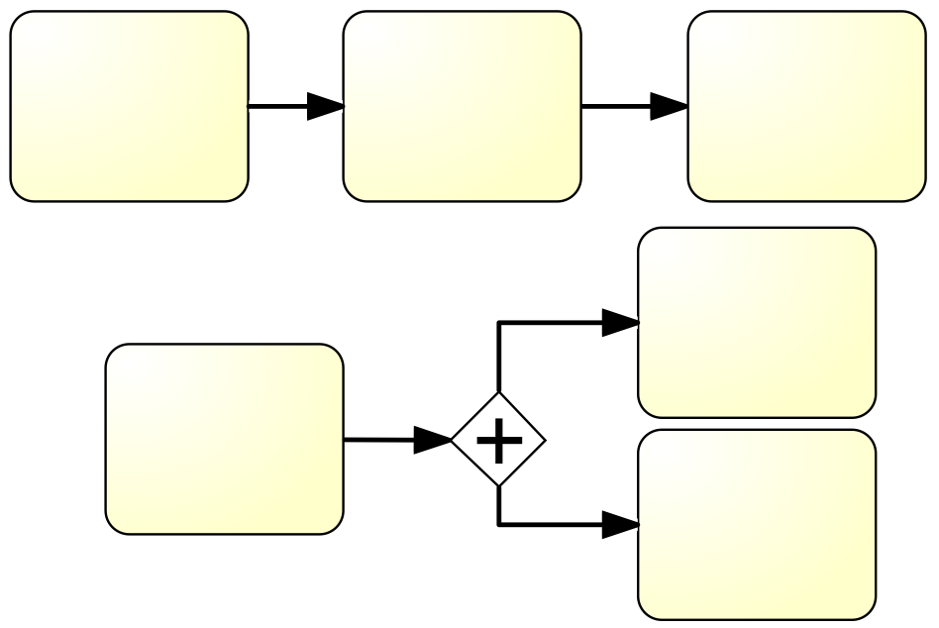
H5. Parallelism enhancement
Parallelize tasks where possible in order to reduce cycle time

Slide 19
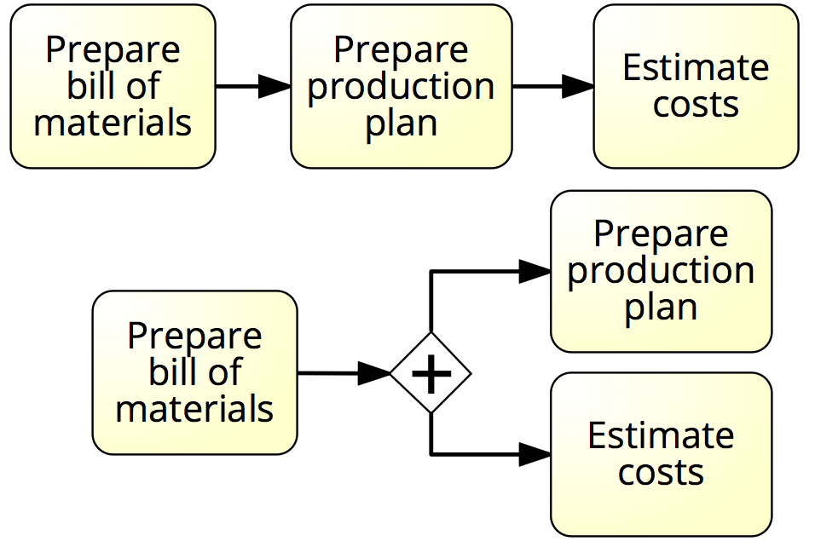
H5. Parallelism enhancement
(T+,C-)
Examples:
Procure-to-pay process: Parallelize “Approve budget” and “Approve necessity of purchase”
Make-to-order process: After “Prepare bill of materials”, perform “Prepare production plan” and “Estimate costs” in parallel
Notes:
Put them in parallel so that the respective resources perform the tasks as soon as these resources are ready
Bill of materials and estimation of costs are done by different resources (engineer and manager), so doing them in parallel allows us to gain in cycle time
Enhance parallelism focuses on improving cycle time, so it has a positive effect on the time dimension. Parallelism has a negative effect on cost. This is because we might be over processing as a result of parallelising. For example, Estimate costs could have been avoided if Prepare production plan leads to an error for which the process instance has to be canceled (not shown in the model)… NOTE: I would replace C- with C+/-
Note: you can only parallelize activities that are data-independent

Slide 20

Process-level redesign heuristics
Process specialization & standardization
Resource optimization
Communication optimization
Automation

Slide 21
H6. Process Specialization/Standardization
Process specialization
One process is split into multiple ones: by customer class, by geographic location, by time period (winter, summer), etc.
Resources are split accordingly
Process standardization
Two processes are integrated
Resources are pooled together
Notes:
Specialization: splitting into variants, per customer class (premium, regular), by geo. locations (NSW vs QLD because of different regulations), by time period (summer, winter). When we split, we will have resources dedicated to one variant as opposed to another variant. The reason could be that different cases have different objectives
Standardization: the opposite, e.g. there’s no business reason for having processes separated by geo location . Resources are pooled together, and therefore achieving economies of scale, but also in order to offer a uniform, repeatable experience to the customer

Slide 22
H6. Process specialization & standardization
Specialization example:
Procure-to-pay process: One process for Direct procurement (e.g. raw materials) and one for Indirect procurement (MRO - Maintenance, Repair and Operations)
Claims handling process: One claims handling process for the summer season (stormy season - peak) and one for the winter season (off-peak)
Standardization example:
Claims handling process: Integrate claims handling for motor insurance across different brands of a group
Specialization: (C+/-, Q+/-, F-)
Standardization: (C+, Q+/-, F+)
Notes:
1) we realize that treating purchase requests the same way may be inefficient. For example, for direct procurements, the objective is not to run out of stock and minimize response time while for MRO we want to comply with certain policies and control cost (everyday’s purchases not needed for production), we don’t want to optimize time and out of stock
2) in order to pool resources together and offer a single uniform experience to our customer regardless of the type of claim lodged
Specialization:
C-: may increase costs because we have separated resource pools and we have to run separate instances (possibly with separate versions of systems which will evolve independently). May decrease costs because more specialized resources are more efficient
Q+/-: quality may increase because of specialized resources, but may also decrease because of a varying customer experience
F-: tends to reduce resource flexibility due to specialized staff, less interchangeable
Standardization:
C+: costs are improved because we have a single pool and exploit economies of scale
Q+/-: customer experience may now be uniform across instances, but quality may deteriorate given that we have a standard way of addressing all cases
F+: flexibility increases due to generalists

Slide 23
H7. Resource optimization
Use resources of a given type as if they were in one room
Avoid one group of people overloaded and another (similar) group idle
Let people do work that they are good at
However, avoid inflexibility as a result of specialization
When allocating work to resources, consider the flexibility in the near future
Allocate work to specialized resources first
Avoid setups as much as possible
Chain multiple instances of the same task [sequential]
Batch multiple instances of the same task [parallel]
Notes:
Groups several guidelines:
1) comes from BPR: use resources of the same type, even if geographically distributed, and allocate work as best as possible in order to avoid that certain resources of a given type are overloaded and others are in idle. What happens however is that in certain state departments, given that geographically there is less work, the resources are in idle, while in others, given that there is more work, the resources are overloaded. E.g. public administration in Italy: certain agencies are overloaded of work, others almost have no work
2) specialization (train them in order to deliver better outcomes), but be careful not to reduce flexibility
3) related to the above, if I can choose between a generalist and a specialist for a given work item, then I should assign it to the specialist, in order to allow the generalist to be used elsewhere, e.g. if the next task requires other skills not possessed by the specialist.
4) Different than composition: chaining work items to the same task allows less handovers and context switches, and handle them in a single trail. Batching is parallel processing, chaining is sequential processing, but here the context switch is meant between different tasks, even within the same process instance, rather then between the same task between different process instances (eg different clients).

Slide 24
H7. Resource optimization
Resource integration example:
Claims handling process: Share resources across different types of claims (e.g. motor and personal insurance)
Batching example:
Claims handling process: Batch all claims for a given geographic area and assign them to the same resources
University admission process: Batch all applications and handle them to the assessment committee
(T+, C+, F+/-)
Notes:
claims handlers can handle different types of claims (increasing F) or
batching all claims geographically and assign them to the same resource in other to minimize context switches, hence delays
T+: because we render the process more efficient
C+: because we reduce handovers and context switches, being more effective in the use of resources. Also because we make them more specialized, which leads to them working more effectively and in less time (hence less costs)
F+/-: because if we specialize we loose in resource flexibility, but if we assign sequential tasks to specialist resources first, in order to keep the generalists free, then we have opportunities to increase resource flexibility

Slide 25
H8. Communication optimization
Automate handling, recording and organization of messages
Monitor customer interactions, record exceptions
Optimize
Number of interactions with customers and business partners
Type of interaction (synchronous vs. asynchronous)
Timing of interactions
(T+,Q+,C+/-,F-)
Notes:
Automate message exchange (internal and external) and record exceptions and monitor interactions.
It’s a form of standardization of communication, hence process flexibility is reduced
Optimize:
1) number of external interactions
2)…

Slide 26
H8. Communication optimization
1. Optimize number of interactions
Gather sufficient information to get to the next milestone (reduce external interactions)
2. Optimize type of interaction
Synchronous interactions effective to resolve minor defects
Asynchronous to notify, inform, resolve major defects, request additional information to reach next milestone
Notes:
1) reduce the number of external interactions (which case waiting - delays) in order to move on to the next logical milestone in our process, rather than asking for more
2) To optimize the type, we need to understand the relative merits of synch vs async interactions. synchronous: we wait for an answer, e.g. a phone call. Useful to resolve simple matters, like asking some details to the customer
Asynchronous: we decouple sending information from receiving an answer, which may even not be required: use via email through notification or information, or when resolving major issues that cannot be done in a single go (so during the duration of the interaction), or when requesting additional information to reach the next milestone

Slide 27
H8. Communication optimization
3. Optimize timing of interactions:
Front-loaded process: bulk of information exchange and processing happens upfront
Complete-kit concept
Back-loaded process: bulk of information exchange and processing happens downstream
Example: CVS Pharmacy in early 2000s
Notes:
Be careful not to back-load the process:
CVS pharmacy (large chain of pharmacies in the US): they introduced
1 hour before pick-up a number of checks were done: if customer was insured, how much from the insurance would be paid to the customer, if medicine was in stock, if it was safe to give it to the customer given his helath history. Clearly a major issue was that issues were only detected just before the customer arrived, and only then the resolution would start. This is during peak time (i.e when customers came out of work in the afternoon), we would try to resolve synchronous interactions in a queue. Customers were super angry because they were expecting to pick up the medicines rather than trying to solve an issue in peak time. This process was back-loaded: too much information processing and exchange at the end of the process. This should be more balanced
Similarly, this could be the other way around: we don’t start the process until we have all information required.
What we need is a nice balance between front load and back load communication

Slide 28
H8. Communication optimization
Complete-Kit Concept: “Work should not begin until all pieces necessary to complete the job are available”
Boaz Ronen
Principles for complete-kit process design:
Provide complete and easy-to-follow instructions for those who will initiate the process.
If a process cannot start, the client should be notified of all defects that could be reasonably identified at the onset of the process
Consider the tradeoff between “incomplete-kit” process initiation vs. roundtrip to revise and resubmit a request
Notes:
Boaz Ronen, “The Complete Kit Concept,” International Journal of Production Research, Volume 30, Issue 10 October 1992, pages 2457 – 2466.
This is an issue with claims handling processes, where more information is needed and we have to get back to the customer a number of times.
This is also typical of government processes and in many cases you are required to gather a lot of documentation and complete a complex form (e.g. for permanent residency in Australia), you submit all documents and then wait a long time before someone will pick it up.
The following principles should be followed:
provide easy and simple instructions for those who start the process (customers)
tell them what are all possible errors and how to fix them, beforehand, in order to avoid that once the case is finally picked, it cannot start because something is missing
balance between complete and incomplete kits: i.e. do an initiation with documents + roundtrip to revise and resubmit requests

Slide 29
H9. Automation
Use data sharing (Intranets, packaged enterprise systems) to:
Increase availability of information to improve visibility and decision-making (subject to security/privacy requirements)
Avoid duplicate data entry and transportation
Use network technology to:
Replace physical flow (e.g. paper documents) with information flow
Enable self-service via e.g. online forms and Web data services
Notes:
Data sharing: Ford procure-to-pay process: they used a shared DB between Purchasing, Accounts payable and Goods in to check what purchase orders had already been fulfilled, rather than manually searching for these
Different forms:
packaged e s: ERP, CRM etc.
2) material or paper documents. Example: the insurance company could send a request via email, or there is a self-service portal or the insurance company accessing the hospital database directly (with certain restrictions).

Slide 30
H9. Automation
Use tracking technology to identify and locate materials and resources
Identification: Bar code, RFID
Location: GPS, indoor positioning
Use business rules technology to automate information processing tasks (including decisions)
Automate end-to-end processes with a dedicated BPM system or system with process automation functionality
(T+,C+/-, Q+/-, F-)
Notes:
3) identify and locate materials and resources used in a process, e.g. RFID and barcode scanners, to track prescriptions e.g. in CVS pharmacy (put a sticker and scan the barcode to know the stage of the process each prescription is), or GPS to locate moving resources, e.g. over relatively large geo. areas
4) capture the business rules behind complex decisions with rules engines (part of a rules management systems) to automate decisions. Decisions are mechanized by capturing the business rules
5) process automation: all interactions and tasks happen at the right moment
---
Automation has a positive effect on time, as some tasks are faster when completed by computers, work handovers are faster and information can be searched faster. As a result, there is often a positive effect on cost, though this is offset by the cost of implementing and maintaining the technology and/or equipment required for automation. Quality can be improved by a reduction in the defect rate, as we reduce risk of human errors. However, there can also be negative effects. For example, if the process is automated too much or in the wrong places, customer or worker satisfaction can be reduced. This usually occurs when automated systems are poorly designed for exception handling. Due to this, flexibility also decreases, as the process is less able to adapt to a wide variety of instances.

Slide 31
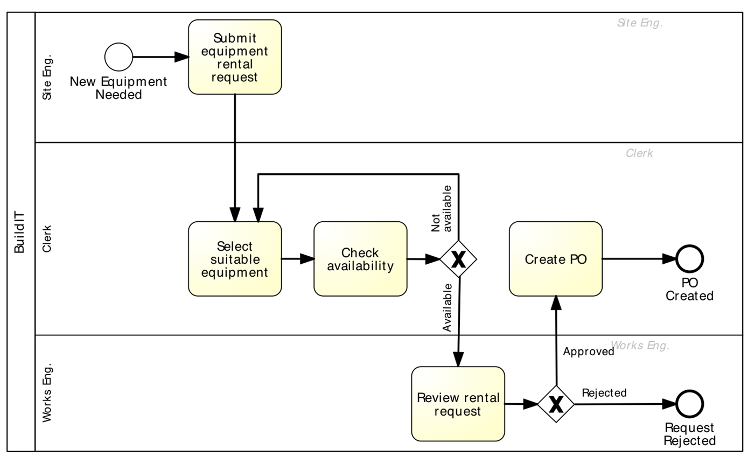
Applying redesign heuristics
Example: Equipment rental process

Slide 32
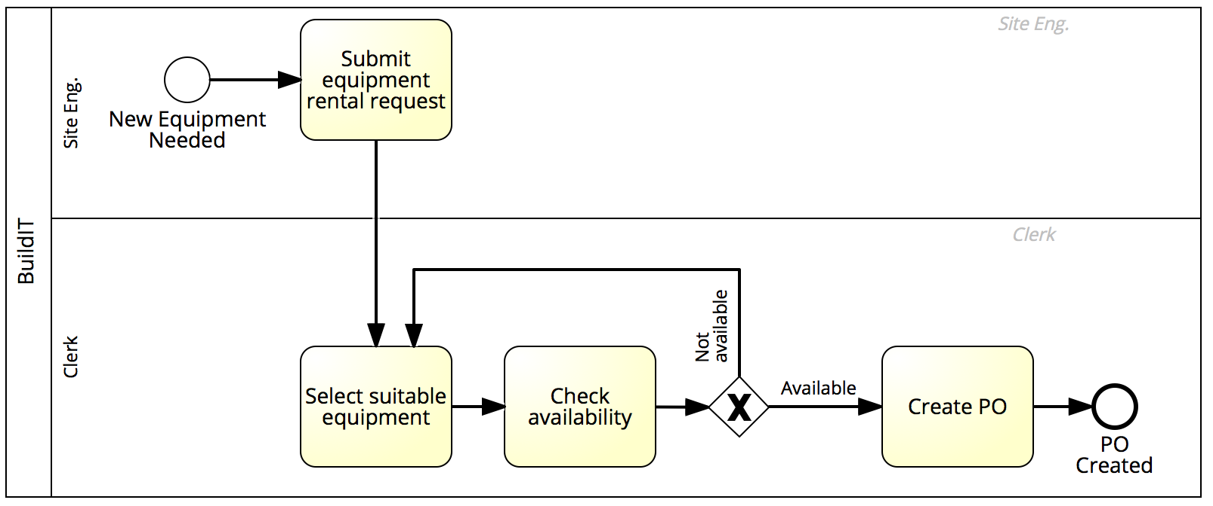
Applying redesign heuristics
Example: Equipment rental process
Heuristic 1: Task elimination
Eliminate “Request for approval” for small equipment
Notes:
E.g. for equipment under $500

Slide 33
Applying redesign heuristics
Example: Equipment rental process
Heuristic 1: Task elimination
Eliminate request for approvals for small equipment
Replace approval in all cases, with empowerment and statistical controls
Notes:
Alternative: Empowerment of site engineers to make requests on their own with clear instructions (for all types of requests), + works engineer doing statistical control from time to time

Slide 34
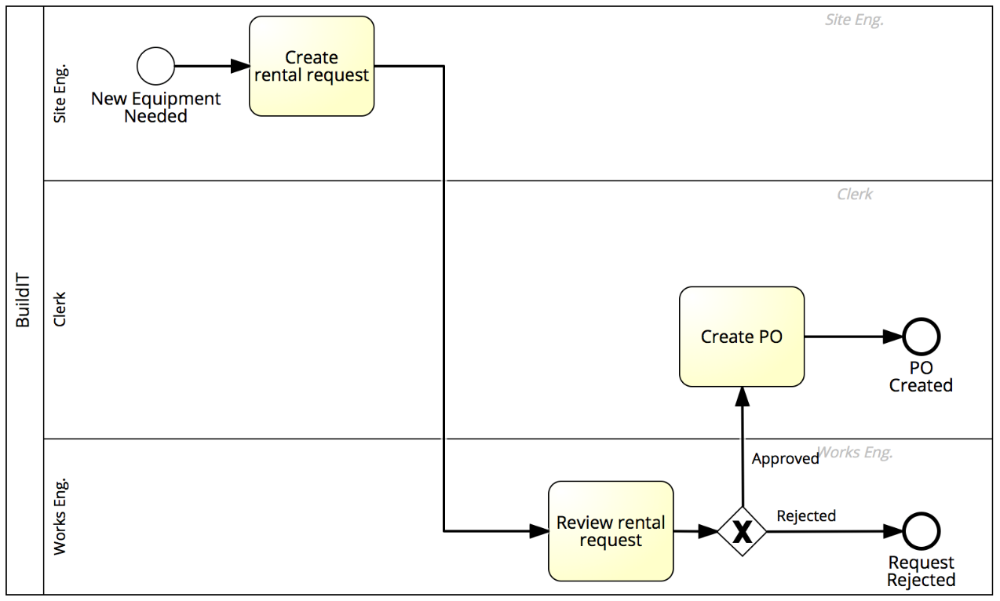

Applying redesign heuristics
Example: Equipment rental process
Heuristic 2: Task composition
Merge equipment selection, availability check and rental request creation
Notes:
H2 to remove transportation between site engineer and clerk by merging the first three activities into one. The approval is still there, but the first three activities are merged and the clerk is only needed for the creation of the PO. The handover of work between works eng and clerk is improved now, replacing two transportations by one.

Slide 35
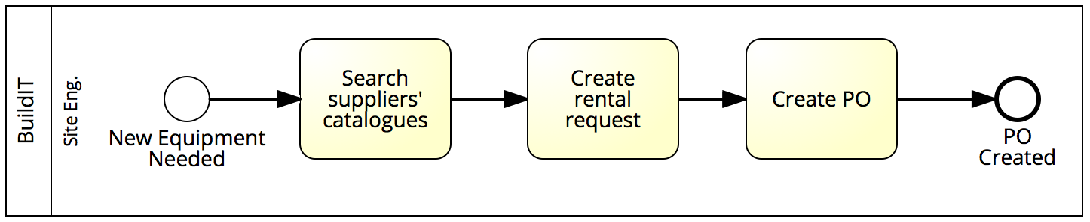
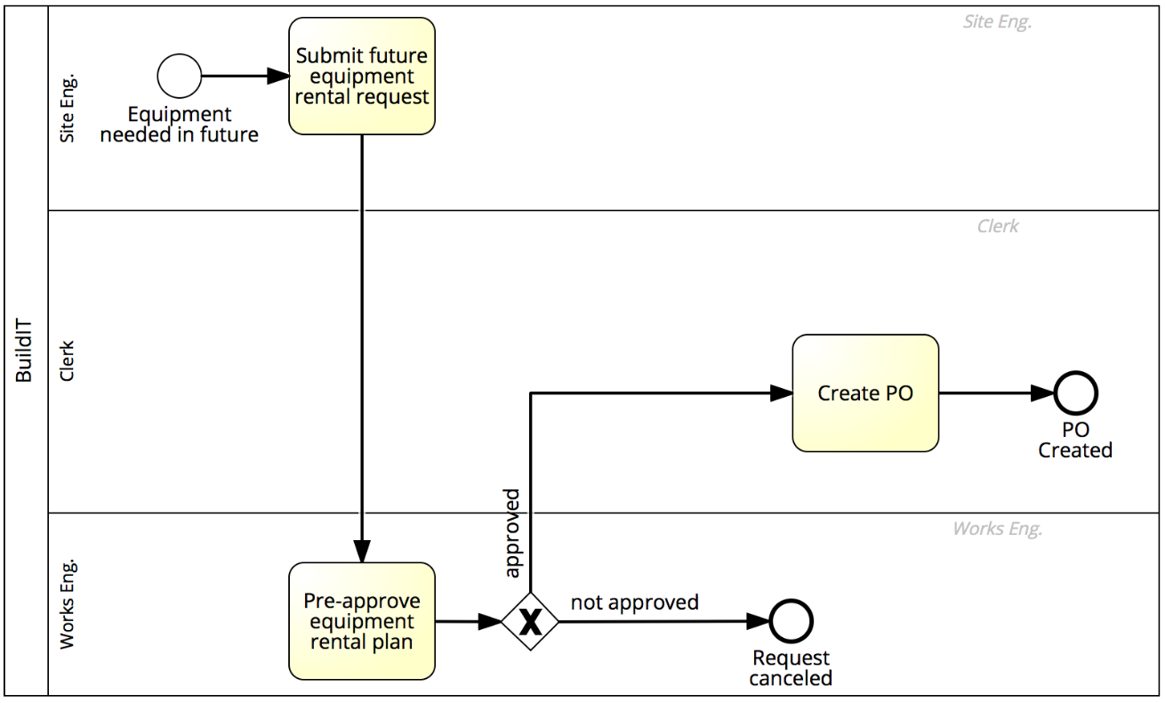
Applying redesign heuristics
Example: Equipment rental process
Heuristic 6: Process specialisation and standardisation
Separate the process for small versus large equipment and streamline the process for small equipment
Large equipment
Small equipment
Notes:
Currently, for small and large requests the activities are the same. If we manage to specialize this, then we can use a streamlined version of this process for small requests where there is no clerk and works engineer anymore to allow them to almost instantly get small equipment, and use a different variant for large requests.
For large requests, use a process based on pre-aprroval and planning, where the site engineer submits their request in advance, e.g. at the start of the week, which will be pre-approved on the basis of the plan and so go directly to the creation of the purchase order. Where is the selection of equipment done?

Slide 36
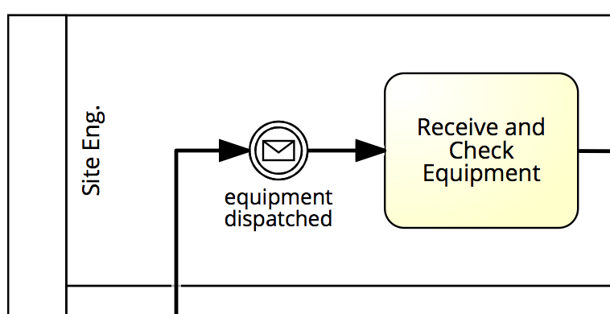
Applying redesign heuristics
Example: Equipment rental process
Heuristic 8: Communication optimisation
Inform the site engineer when the equipment is dispatched
Notes:
The site engineer doesn’t really know when the equipment will arrive, sometime even the wrong piece of equipment will arrive. In this case, the site engineer is informed when the equipment is dispatched and they are reassured

Slide 37
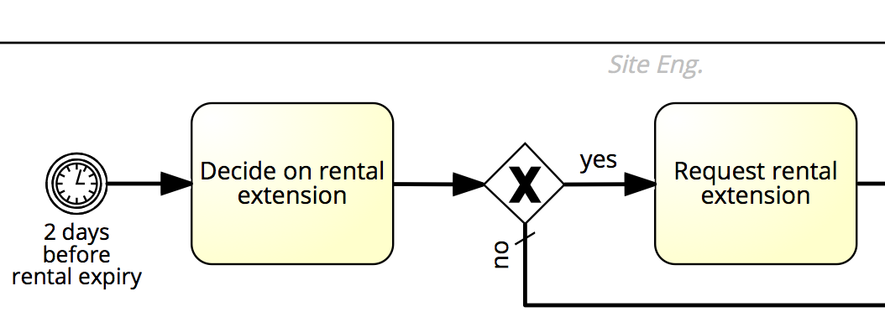
Applying redesign heuristics
Example: Equipment rental process
Heuristic 8: Communication optimisation
Inform the site engineer when the equipment is dispatched
Add interaction to handle extensions
Notes:
Site engineers sometimes have to ask for extensions. We can handle this by triggering a process 2 days before the rent expires in order to decide on rental extension, to avoid letting this expire
NOTE: replace intermediate timer event with start timer event

Slide 38
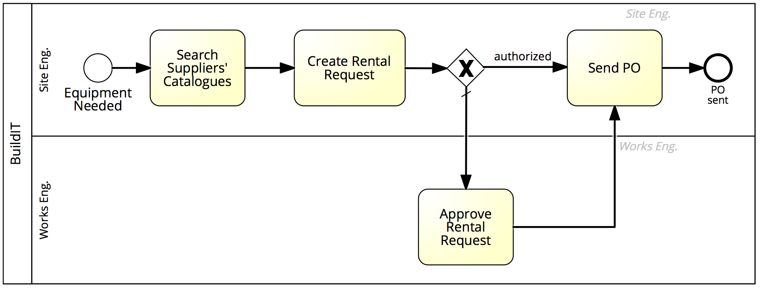
Redesign output: to-be process model
Example: Equipment rental process
Notes:
38
Just an example: when the clerk has been removed by merging the second and third tasks and assigning them to the site engineer

Slide 39
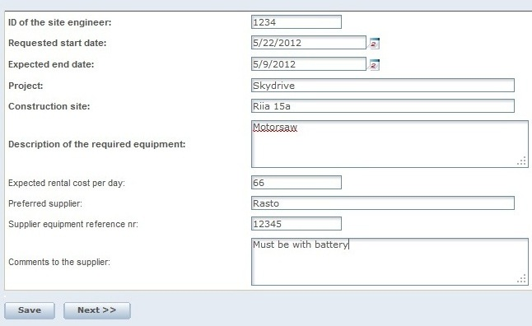
Applying redesign heuristics
Example: Equipment rental process
Heuristic 9: Process automation
Use self-service for the equipment search and availability checking
Notes:
The site engineer directly consults the catalogue, AFTER we have removed the clerk. Remember ACI case

Slide 40

Applying redesign heuristics
Example: Equipment rental process
Heuristic 9: Process automation
Use self-service for the equipment search and availability checking
Use process automation to coordinate handovers
Process Support System
Notes:
Finally, automating the whole lot.

Slide 41
Redesign heuristics for Equipment rental process
Heuristic 2
I3. Compose equipment selection, availability check and rental request creation
Heuristic 6
I4. Separate process for small vs. large equipment, streamline “small” process
Heuristic 1
I1. Eliminate request for approvals for small equipment
I2. Replace approval with empowerment & stat. controls
Notes:
I3 means removing the first interaction with the clerk, who is not involved until PO creation

Slide 42
Redesign heuristics for Equipment rental process
I7. Use self-service for equipment search and availability checking
I8. Use process automation to coordinate handovers
Heuristic 9
I5. Inform site engineer when equipment dispatched
Heuristic 8
I6. Ask site engineer if extension required
Notes:
I7 can be combined with I3 (composition of first 2-3 tasks to avoid clerk)

Slide 43
PICK chart
Prioritizing redesign options
Impact
BIG payoff
SMALL payoff
Implement
Possible
Statistical controls
Eliminate approvals for small equipment
EASY to implement
Combine tasks
Difficulty
Challenge
Kill
HARD to implement
Automate
Specialise
Inform
Notes:
43
Implement: low hanging fruits
Challenge: consider, but these are really challenging, so may be given less priority
Possible: small payoff, so be given less priority, if resources are available
Kill: do not consider.
Eliminate approvals for small equipment only: just put in place new instructions for clerks and works engineers
Statistical controls: empower site engineers + stat control for all rent types (small, large). Larger payoff, again define guidelines so the works engineer can double check. Again, simple to implement but larger payoff
Combining tasks to get rid of first involvement of clerk for all rent types (small, large): relatively easy to implement: empower site engineer and instruct them how to do it. Relatively easy to implement and large payoff since clerk is removed in the first part of the process, so less handovers
Specialize: one variant for small, one for large: as small equipment is less important, we will focus on the large cases, but we have to design two different variants with different sets of instructions, training etc. Hence kill
Inform (H8): The option of receiving the notification from the supplier is relatively difficult to implement as it requires interaction with supplier who will inform us when something is dispatched (external process to be changed). Big payoff as it will give the site engineer more visibility but implies change in the supplier’s process, not easy. The other H8 (trigger renewal request 2 days before expiry) is simpler to implement and has a big payoff. NOTE: create separate dot
Automate (H9): large payoff in terms of reducing defects and increasing visibility and reducing cycle time. But hard to implement given the whole infrastructure we have to set in place
Now this is a matter of business case development in a discussion session. Make business cases for each redesign options.

